Slide 1



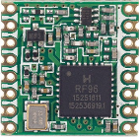
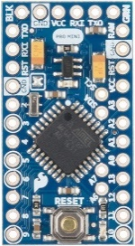



Power (pin A)
Rectifier
Regulator
SuperCap
Antenna
Common (pin I1)
LoKy
Hardware
Optocoupler
Decoder (pin I2)
Firmware
Info_TIC
Node-RED
Application Server

Slide 2
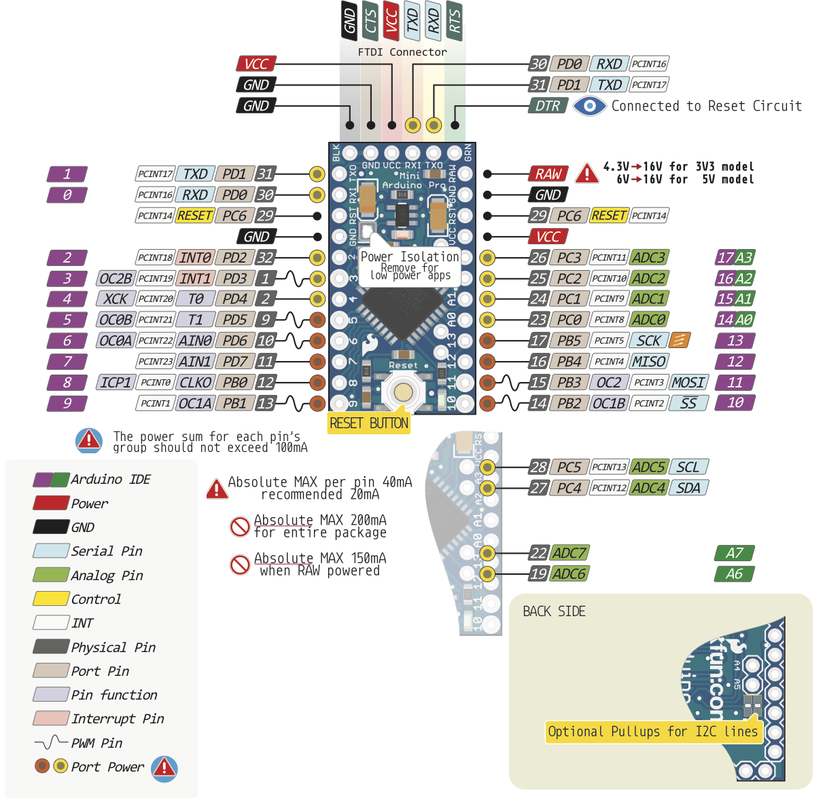
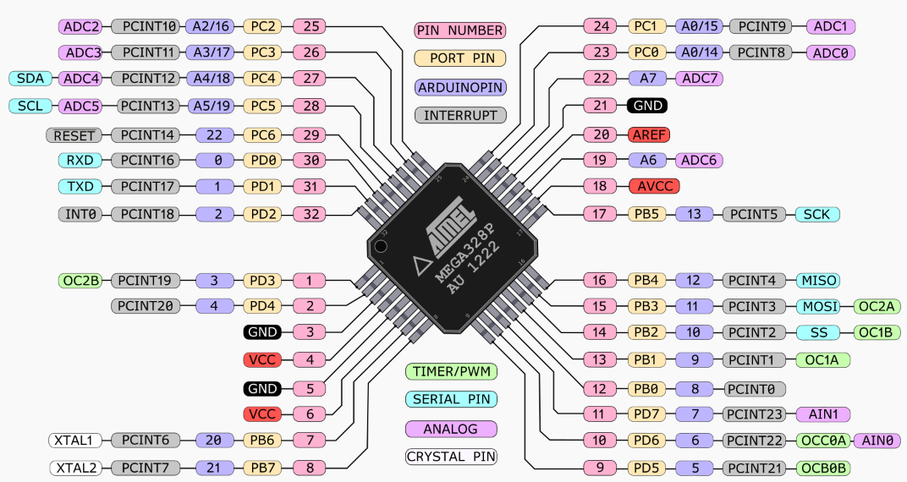
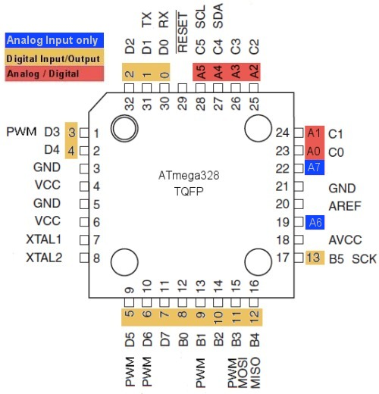

Slide 3
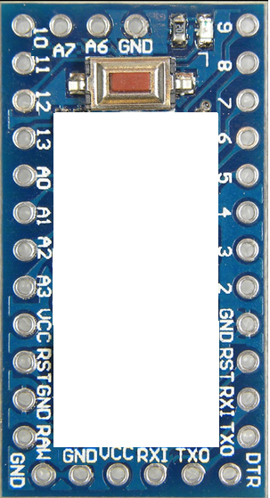
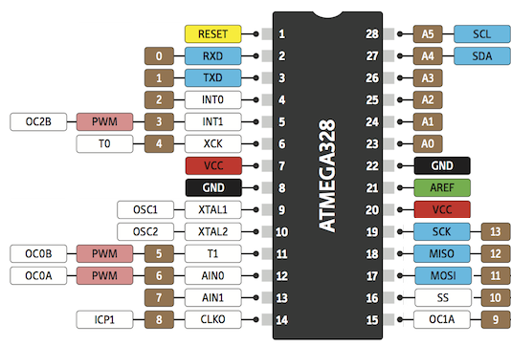
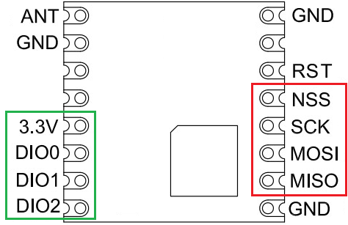
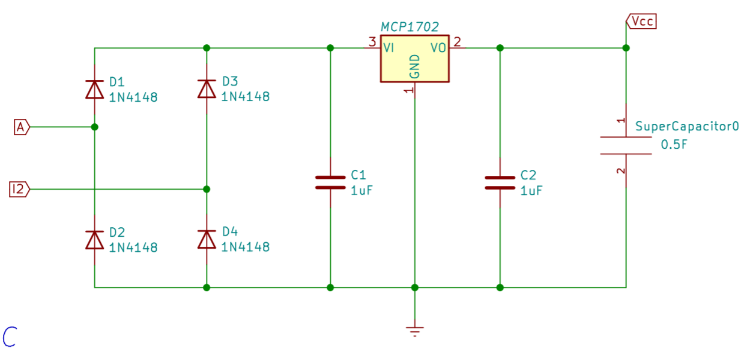
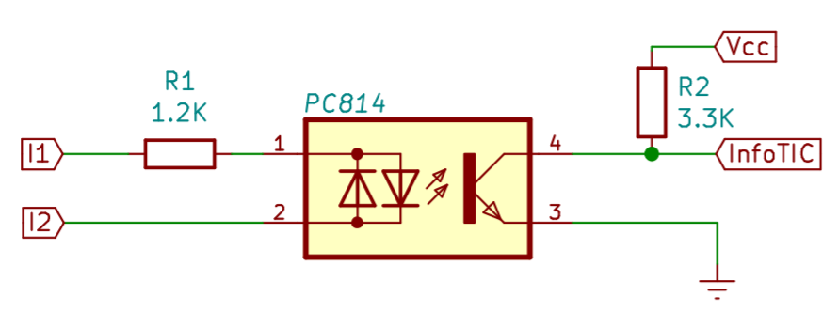
NSS
MOSI
MISO
SCK
DIO2
RST
DIO1
info_TIC
DIO0
3V3
GND

Slide 4
